Slide 1
Army Cadet Force Shooting CONFERENCE
Maj Simon Mann RA
SO2 Cadet training ops
25 JAN 2020

Slide 2
ACFSC
Brig MP Christie OBE

Slide 3
Army Cadet Force Shooting COFERENCE
CREES
WO1 HQ RC
24JAN2020

Slide 4
ACFSC
G4 Update
WEAPONS
AMMUNITION
EQUIPMENT SUPPORT

Slide 5
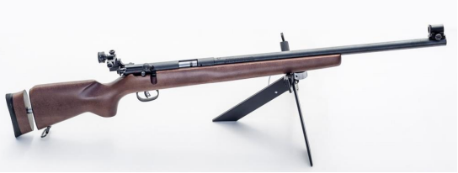
ACFSC
WEAPONS
CADET SMALL BORE TARGET RIFLE (CSBTR)
L144A1

Slide 6
ACFSC
WEAPONS
Total Fielded 3792.
Equipment Support.
  Butt Assembly Engineering Solution.
  Rear Sight Grub Screw now codified.

Slide 7
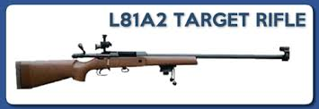
ACFSC
WEAPONS
CADET TARGET RIFLE (CTR)
L81A2

Slide 8
ACFSC
WEAPONS
Total Fielded 1269 (+50).
Equipment Support.
  No Spares solution.
  Limited Qtys of Front Sling Loops remaining.

Slide 9
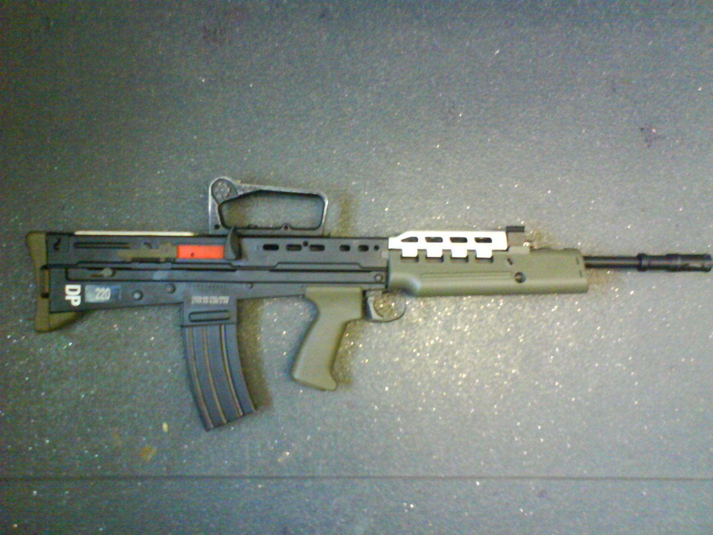
ACFSC
WEAPONS
(CADET) Drill Purpose
L103A2

Slide 10
ACFSC
WEAPONS
Total Fielded 8445.
  Possible reduction <50% (4223)
Equipment Support.
  No Issues.

Slide 11
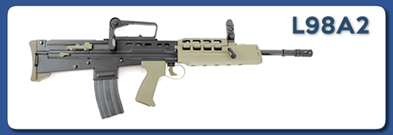
ACFSC
WEAPONS
(CADET) General Purpose
L98A2

Slide 12
ACFSC
WEAPONS
Total Fielded 15,629.
Future Program.
  Currently not included in the A2-A3 Program
Equipment Support. BAU

Slide 13
ACFSC
WEAPONS
WEAPON TYPE | QTY
CADET SMALL BORE TARGET RIFLE (CSBTR) L144A1 | 3792
CADET TARGET RIFLE (CTR) L81A2 | 1269
(CADET) Drill Purpose L103A2 | 8445
(CADET) General Purpose L98A2 | 15,629
TOTAL | 29,135

Slide 14
ACFSC
Ordnance, Munitions and Explosives
ADAC | Designation | DofQ | PPQ
10101-01 | PELLET AIR GUN .177 INCH | EA | 1000
10505-02 | RD 0.22IN LR CLUB L1A1 | EA | 5000
11901-04 | ROUND 5.56MM BALL CARTON L17A2 | EA | 900
11909-05 | CARTRIDGE 5.56MM BLANK CARTON L18A1 | EA | 1000
12003-13 | ROUND 7.62MM BALL CARTON L44A1 | EA | 560
12004-03 | ROUND 7.62MM BALL SNIPER L42A3 155 GRN | EA | 560
12712-01 | ROCKET HAND FIRED PARACHUTE ILLUMINATING 300M L24A1 | EA | 24
12808-01 | SIGNAL KIT PYROTECHNIC PISTOL 16MM WHITE L89A1 | KT | 28
13202-02 | FLARE TRIPWIRE KIT L10A2 | EA | 2
13804-01 | SIMULATOR BATTLE SOUND L35A1 | EA | 50
16517-03 | GRENADE HAND SMOKE SCREENING L132A1 | EA | 12

Slide 15
ACFSC
Ordnance, Munitions and Explosives
ADAC | Designation | DofQ | 2020-21
10101-01 | PELLET AIR GUN .177 INCH | TIN | 130
10505-02 | RD 0.22IN LR CLUB L1A1 | EA | 822,800
11901-04 | ROUND 5.56MM BALL CARTON L17A2 | EA | 1,574,550
11909-05 | CARTRIDGE 5.56MM BLANK CARTON L18A1 | EA | 4,241,700
12003-13 | ROUND 7.62MM BALL CARTON L44A1 | EA | 89,370
12004-03 | ROUND 7.62MM BALL SNIPER L42A3 155 GRN | EA | 125,000
12712-01 | ROCKET HAND FIRED PARACHUTE ILLUMINATING 300M L24A1 | EA | 1,046
12808-01 | SIGNAL KIT PYROTECHNIC PISTOL 16MM WHITE L89A1 | KT | 763
13202-02 | FLARE TRIPWIRE KIT L10A2 | EA | 223
13804-01 | SIMULATOR BATTLE SOUND L35A1 | EA | 2,460
16517-03 | GRENADE HAND SMOKE SCREENING L132A1 | EA | 4,080

Slide 16
ACFSC
Ordnance, Munitions and Explosives
Un-Supported.
  Sport Shooting Cartridge Shotgun 12 Bore.

Slide 17
ACFSC
EQUIPMENT SUPPORT
Cadet Light Weight Weapon Contract.
Maintenance, Repair and Overhaul Level 1-3.
  Including Forward Repair Teams in support of national events.

Slide 18
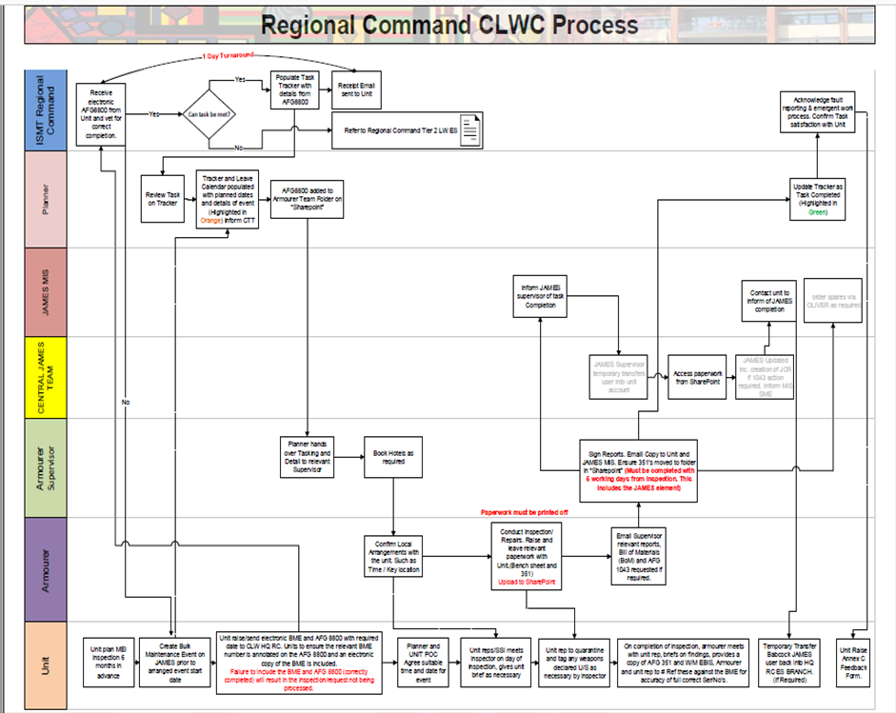
ACFSC
EQUIPMENT SUPPORT

Slide 19
ACFSC
EQUIPMENT SUPPORT
D Eqpt 2981, JAMES Governance dated 19 Mar 12 states - the JAMES CIWG and FLC JUG have been given clear direction on the use of JAMES as the equipment management IS of choice. At the CIWG on 26 Apr 12 the Equipment Director stated:
“Consenting to fail, evading responsibility or avoiding engagement in the use of JAMES is not negotiable”

Slide 20
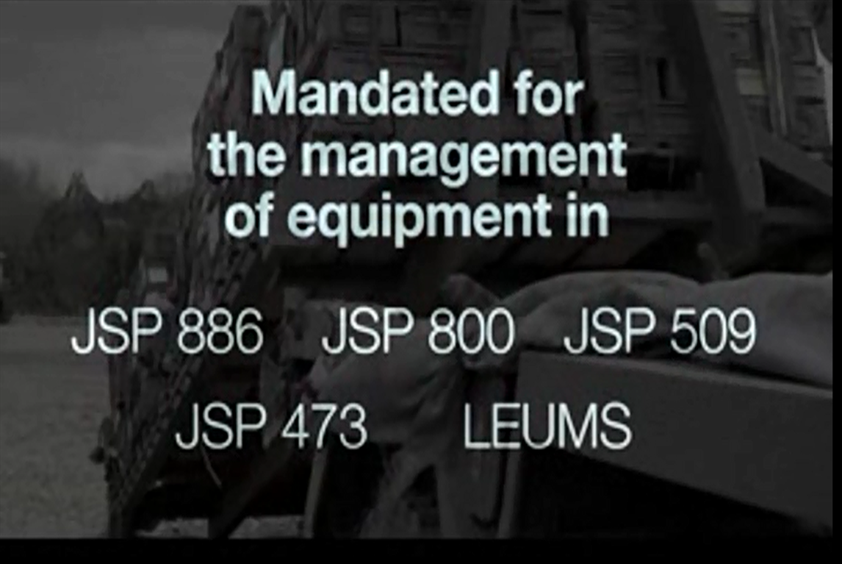
ACFSC
EQUIPMENT SUPPORT

Slide 21

ACFSC
QUESTIONS

Slide 22
Army Cadet Force Shooting CONFERENCE
Maj Simon Mann RA
SO2 Cadet training ops
25 JAN 2020

Slide 23
HQRC
RC Update
Shooting Syllabus
Cadet Shooting and Marksmanship Manual
Firing of Non-Cadet Weapon Systems –
2* Dispensations
Focus on building the coaching base
Movement of weapons
Maj SC Mann RA

Slide 24
HQRC
ACSMS
Key Terms:
CASP: Cadet Action and Safety Plan
AO: Activity Owner (Planning Offr)
SAO: Senior Activity Owner (SPO)

Slide 25
HQRC
ACSMS PROCESS
Receive Delegated Authority Letter
Assign SAO and AOs
Obtain Authority in Principle (AiP from SAO)
Generate WESTMINSTER event/course
Plan – generate: CASP and/or RSD/RASP
Seek advise (TSA)
Submit to SAO
SAO authorises (if delegated authority)
SAO Passes up assurance chain (if not delegated authority)

Slide 26
HQRC
ACSMS Example
.22 Practice during Det Night at own range
DC (AO) has delegated authority to run range (as he holds a range qual and range is Safe Place and on Det Night as BAU). Armoury and bunker in location.
AO produces an RSD referring to the Range Standing Orders (RSOs) in place. Submits RSD to assigned SPO for check.
SPO signs off RSD.
AO Signs on to range and conducts as per the RSOs.
AO records results in WESTMINSTER (see later Slide).
BAU: Business as Usual

Slide 27
HQRC
ACSMS Example
Full Bore 2* 25m Shoot at local Barrack Range an a Wkd
DC (AO) does not have delegated authority to run range, but Area Comd (SAO) does have delegated authority.
AO Seeks Authority in Principle (AiP) from SAO (who also acts as the SPO).
AO produces a CASP with RSD referring to the Range Standing Orders (RSOs) in place. Consult TSA if required and submit to SAO.
SAO returns authorised CASP and RSD. AO conducts range.
AO Records results in WESTMINSTER
CASP – Cadet Safety Action Plan; includes all general safety and admin instructions for whole event

Slide 28
HQRC
Recording shooting results
We need to record shooting results correctly to reflect the actual shooting that is happening:
Bulk load shooting results using the shoot name (CLF: Cadet Live Fire) practice in the ‘shooting syllabus’
In the notes add: Name of RCO and Location of range
CFAVs. Intent is to have range activity modules to record CFAV roles on range. Range Location and type recorded in notes. This allows ‘Currency’ checks to be recorded and checked.
Top Tip: Load the Modules into the event to ease bulk loading later.

Slide 29
ACSC
RC Update
Any Questions?
Maj SC Mann RA

