Slide 1
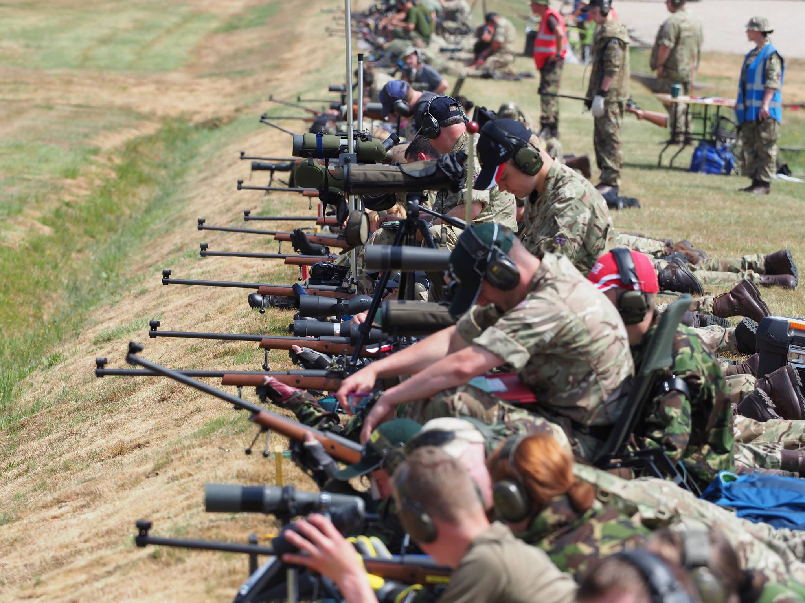
BRIEFING FOR ACF SHOOTING OFFRS JAN
2020

Slide 2
Who are CCRS
Competitions Available
Who’s Entering
Problems
a. Cadet Hundred
b. News of the World
c. ISCRM / CISSAM
d. Clay
Where to look for Information
Questions

Slide 3
MISSION STATEMENT
Promote and organise the sport of competition shooting across the 4 cadet youth movements
in order to
assist the development of individuals’ characters and promote good citizenship.

Slide 4
CCRS DELIVERABLES
National events. 7.62, 5.56, .22/air, clay.
International teams. UK Cadet Rifle Team (U17).
British Cadet Rifle Team (U18).
Great Britain U19 Rifle Team.
Sponsorship of cadets. 30 – NRA Imperial Meeting – whole competition.
44 - Cadet Imperial Meeting – for promising 14/15 years old cadets.
Coaching courses. For CFAVs.

Slide 5
CCRS DELIVERABLES
National events - Teams
 | 2017 | 2018 | 2019
ISCRM | 84 | 94 | 100
CCF Schools | 39 | 40 | 37
CISSAM | 53 | 56 | 65
Commonwealth SB | 26 | 39 | 95 (to date)
Commonwealth FB | 21 | 37 | 37 (to date)
.22 Team (Country Life) | 131 | 57 | 107
SB Winter League (Indls) | Not available | 91 | 218
Clays | 27 | 35 | 41

Slide 6
RELATIONSHIPS
MoD
CCF
MoU
SCC
functional
authority?
CCFA
ACFA
CCRS
ACF
ATC
NRSA
NRA
British Shooting
CPSA

Slide 7
COMPETITIONS

Slide 8
AIR RIFLE
County
Commonwealth Match F 6 Yrds
Commonwealth Match G 10 M

Slide 9
SMALLBORE
County / Brigade
ACF Cadet Hundred - indiv & team
News of the World - det team
Cadet .22 Team Comp - det team
Ffennell A and B – indiv
Smallbore Winter League

Slide 10
SERVICE RIFLE
County Meetings
Brigade SAAM’s
CISSAM – Pirbright/Altcar
Commonwealth Matches D & E

Slide 11
TARGET RIFLE
County Meetings
Brigade TR Meetings
Commonwealth Match C
ISCRM – Bisley
NRA Imperial Meeting – Bisley
Cadet L81A2 Imperial Meeting
National Teams abroad

Slide 12
CLAY
County Meetings/Annual Camps
Brigade Meetings
CCRS – Clay Shoot

Slide 13
ADULTS
Commonwealth Matches
Smallbore Winter League
ISCRM, CISSAM
NRA Imperial Meeting
Cadet Imperial Meeting
CCRS Clay Course/Competition
Overseas Tours

Slide 14
The Competition Shooting Seasons
BCRT Canada
GB U19 South Africa
RCAC Phase 2 Cse
NRA TR MEETING
ANNUAL CAMPS
ISCRM
CISSAM
BDE TR MEETING
BDE SR MEETING
ACF CDT HUNDRED
NEWS OF THE WORLD
MAR
APR
MAY
JUN
JUL
AUG
SEP
OCT
NOV
DEC
JAN
FEB
FULL BORE TARGET RIFLE
SERVICE (GP) RIFLE
.22
CLAY
.22 RIFLE

Slide 15
The Cadet Hundred Competition
Who’s Entering?

Slide 16
ACF 100
 | 2017 | 2018 | 2019
Individuals | 957 | 877 | 1002
Detachments | 200 | 209 | 211
Counties | 25 | 24 | 31

Slide 17
The News of the World Competition
Who’s Entering?
28 Teams Entered | 21 NCR
Cleveland ACF | RSB Hamilton ACF
Dawley Bank ACF | B Company ACF
Glasgow & Lanarkshire ACF | RSB Motherwell
Markethill ACF | Shifnal ACF
Norfolk ACF | Staff & West Mid
Notes:
ATC had 28 entries 5 DSQ and 8 NCR

Slide 18
YOU SHOULD ALL BE !
If entered into ‘The Cadet Hundred Competition’ why not enter both?

Slide 19
PROBLEMS

Slide 20
PROBLEMS
Lack /No Information
Stickers
Signatures
Index Numbers
Coaching?
DSQ

Slide 21
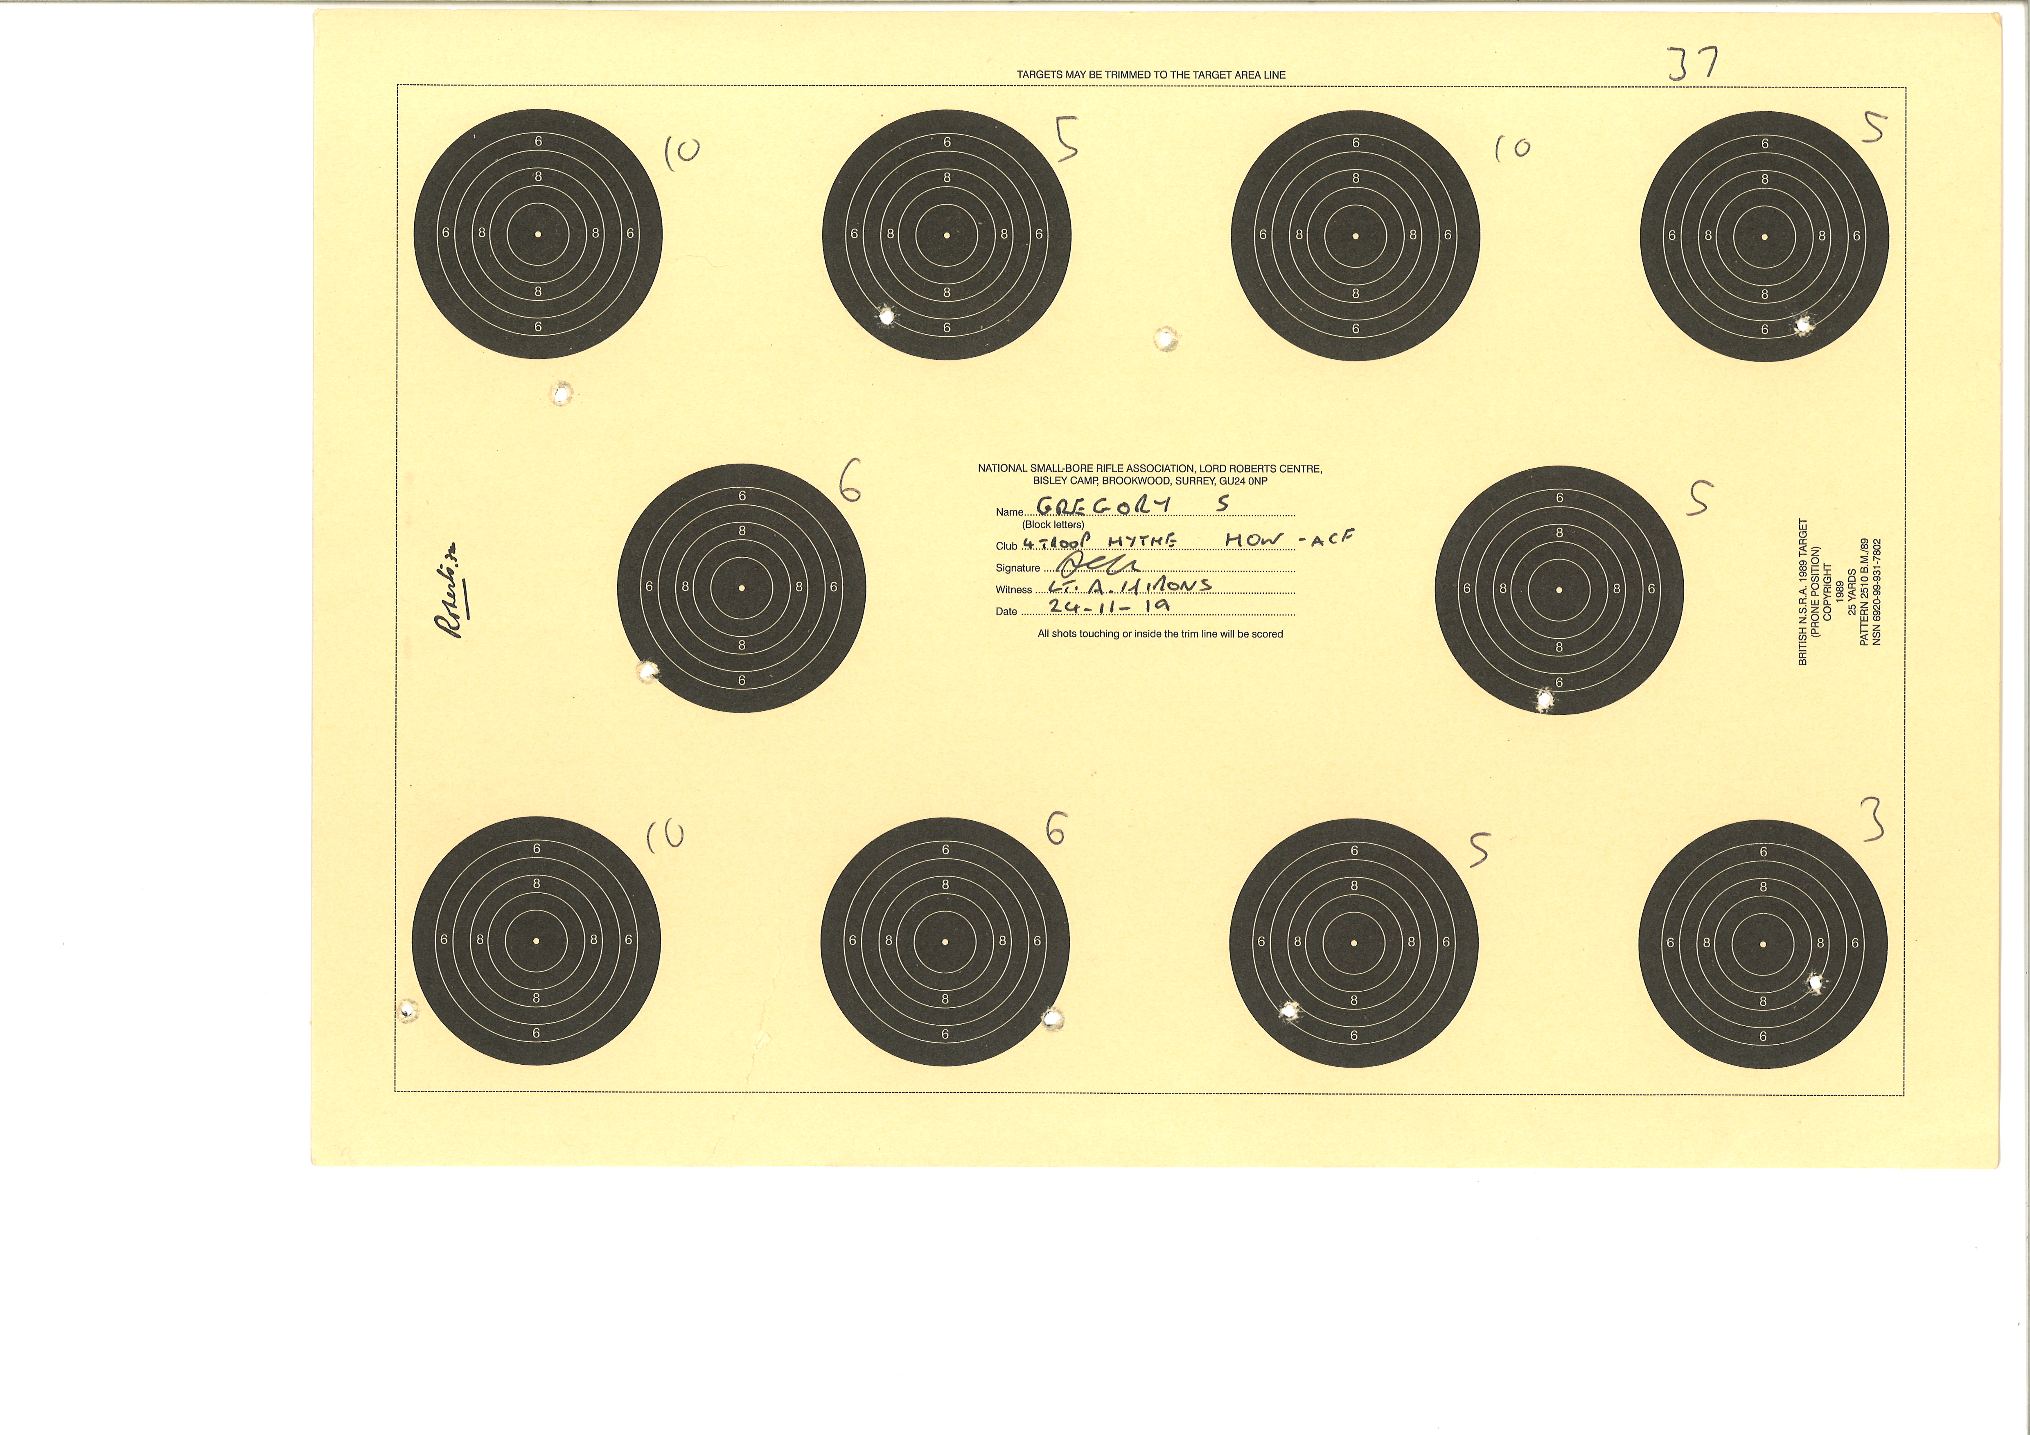

Slide 22
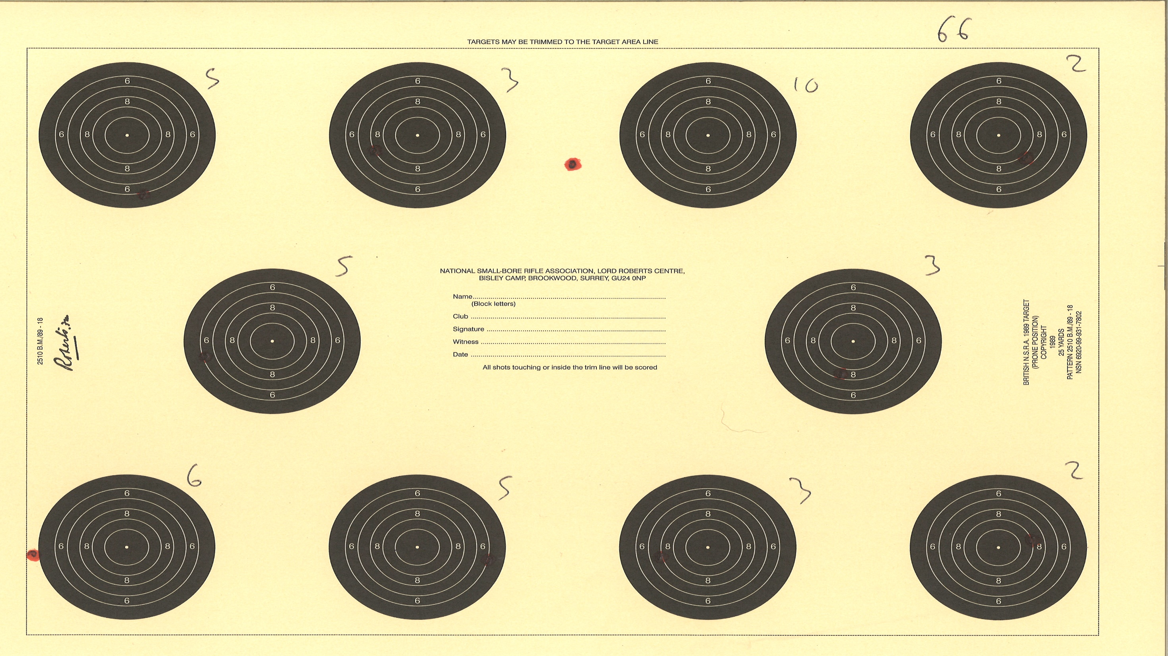

Slide 23
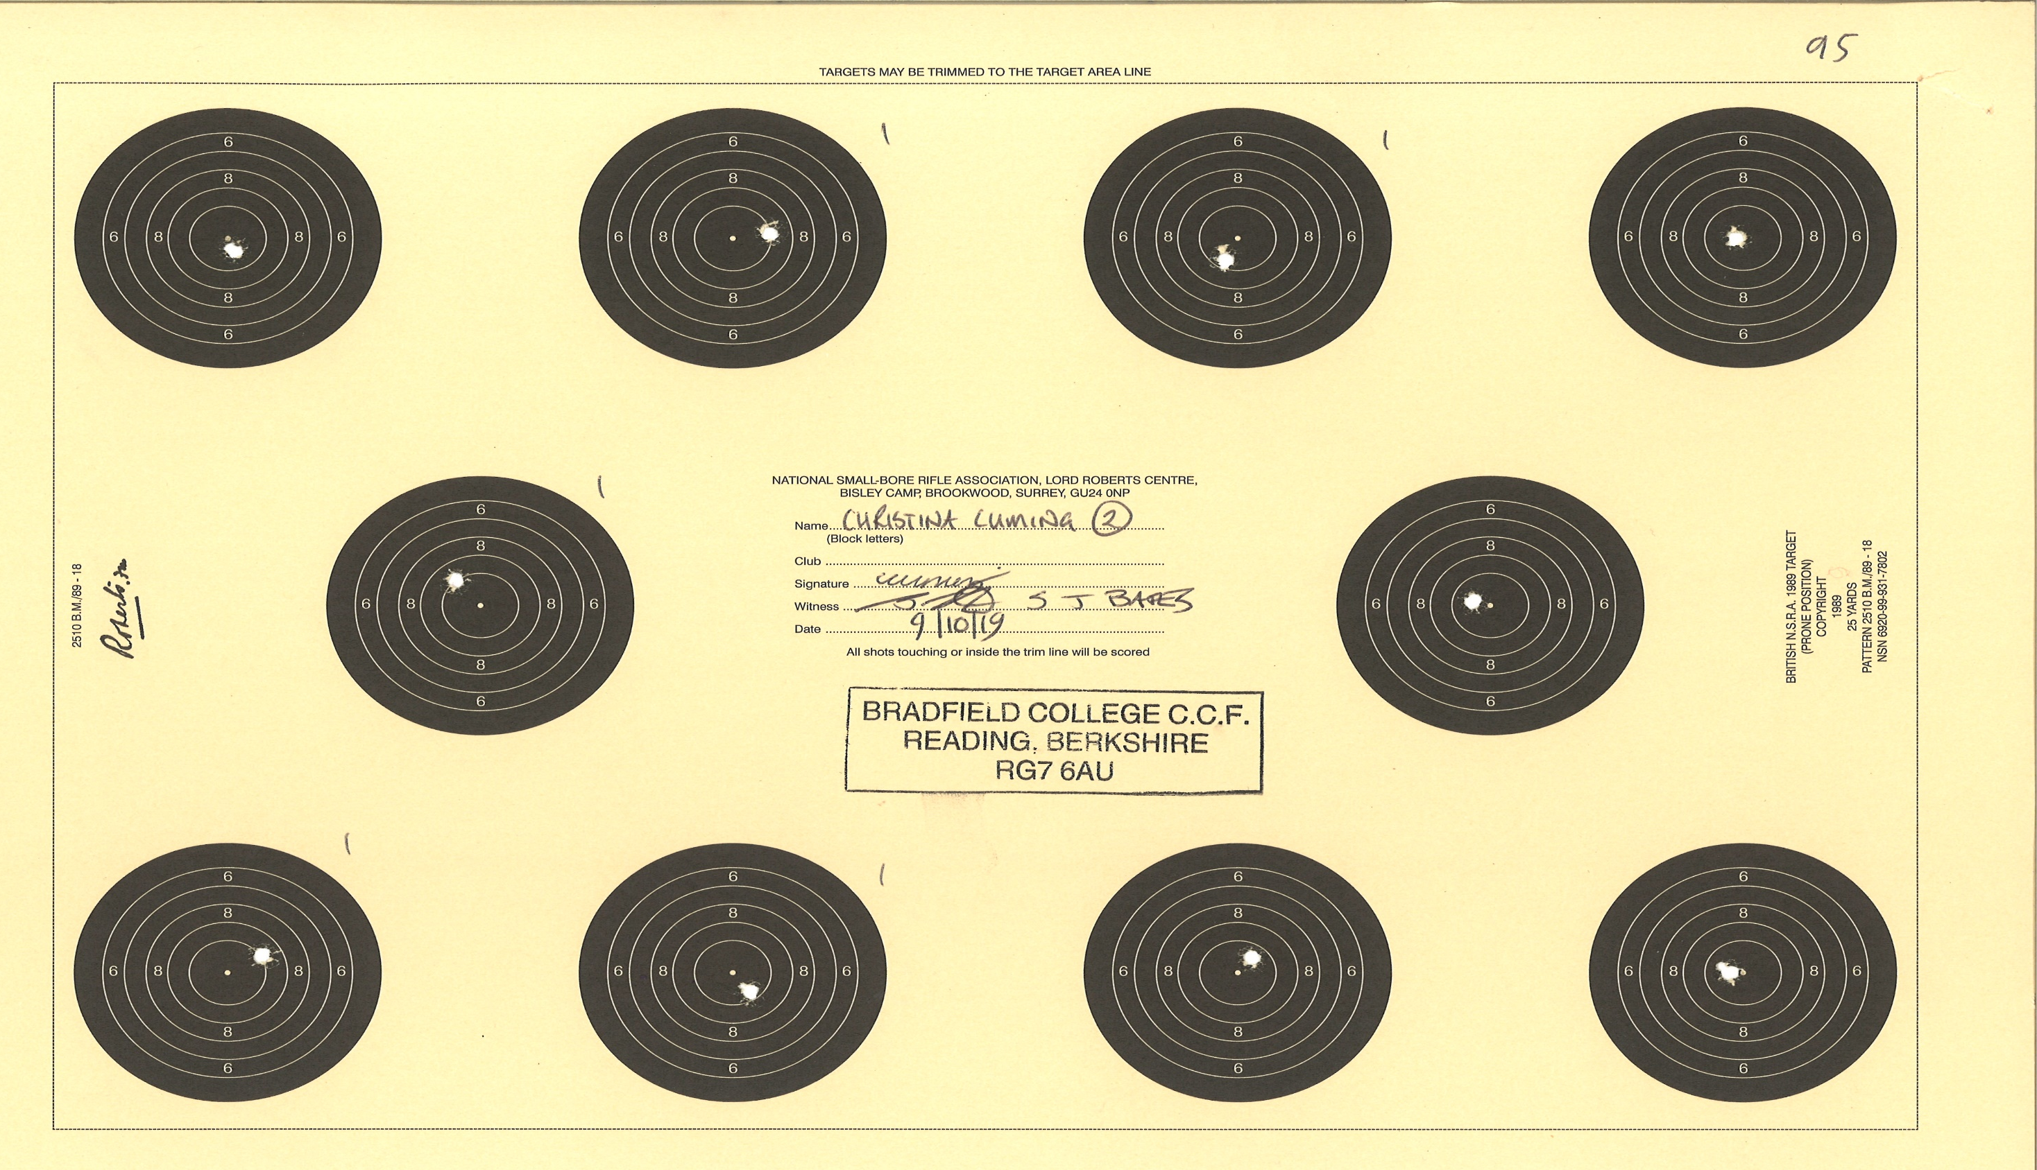

Slide 24
The ISCRM Competition
Who’s Entering?
57 Teams applied |  |  | 53 Attended
1st (NI) Bn | Dorset | Lancashire | Surrey
2nd (NI) Bn | Dyfed and Glamorgan | Lincolnshire | Warwickshire
Argyll and Sutherland Highlanders | Essex | Middlesex and North West London | Yorkshire N&W
Bedfordshire & Hertfordshire | Glasgow & Lanarkshire | Northumbria
Clwyd & Gwynedd | Greater Manchester | Oxfordshire
Derbyshire | Gwent and Powys | Shropshire
Devon | Humberside & South Yorkshire | Somerset

Slide 25
WHY ?

Slide 26
The CISSAM Competition
Who’s Entering?
36 Teams applied | 25 Selected | 23 Attended
1st (NI) Bn | Devon | Northumbria
2nd (NI) Bn | Dyfed and Glamorgan | Somerset
Bedfordshire & Hertfordshire | Essex | Staffordshire & West Mids
Cambridgeshire | Gloucestershire | Team
Cheshire | Greater Manchester | Warwickshire & West Mids
Cornwall | Humberside & South Yorkshire | Wiltshire
Cumbria | Lancashire

Slide 27
WHY ?

Slide 28
Clay
National Clay Shoots
Clay Training
c. Review of Clay Policy

Slide 29
Where to look for Information
CCRS website www.ccrs.org.uk or Call
ACF Shooting Directive
CTC

Slide 30
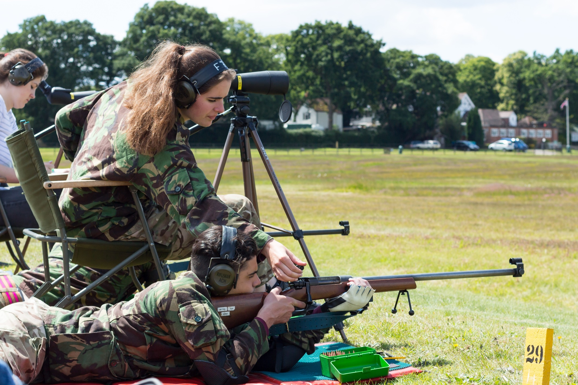
Questions

