Slide 1
Army Cadet Force Shooting Officers’ Conference 24-26 Jan 2019

Slide 2
ACF Shooting Officers’ Conference
Lt Col Mark Geernaert-Davies
Regional Army Cadet Shooting Advisor
Chairman Army Cadet Shooting Committee

Slide 3
Why are we here?
ACF Shooting Officers’ Conference
What do we do?
How do we do it?
What are the problems / issues?
How can we do better?
raise standards
increase participation

Slide 4
ACF Shooting Officers’ Conference – what do we do?
Defence Cadet Shooting Policy 2010
Shooting is integral to achieving aims as national youth movement – a vital part of the ‘cadet experience’
All cadets given opportunity to shoot – syllabus
Field training should be conducted with cadets carrying GP rifles
Cadets also given opportunity to become excellent competitive shots
In pursuit of excellence, cadets must be given opportunity to prepare for shooting at the highest level in the adult world
ARMY CADET FORCE
MAKE YOUR MARK

Slide 5
ACF Shooting Officers’ Conference – what do we do?
Defence Cadet Shooting Policy 2010
Should be progressive from simple and undemanding to the difficult and demanding
Variety of types must be available from air rifle to long range target rifle
Cadets should be able to use civilian rifle club facilities and share facilities on military ranges with civilian clubs
ARMY CADET FORCE
MAKE YOUR MARK

Slide 6
ACF Shooting Directive 9 May 14
MISSION: to deliver safe and rewarding shooting activities:
Syllabus
Competitions
EXECUTION:
Opportunities to be fully exploited
Main Effort = ACF counties
Tasks
ARMY CADET FORCE
MAKE YOUR MARK

Slide 7
ACF Shooting Directive 9 May 14
TASKS:
Council for Cadet Rifle Shooting (CCRS)
Regional Bdes / Lond Dist
ACF Shooting Committee
ACF Counties
ARMY CADET FORCE
MAKE YOUR MARK

Slide 8
ACF Shooting Directive 9 May 14
TASKS:
ACF Counties
County Shooting Officer
Adult Training
Cadet Training Syllabus
Competitions
ARMY CADET FORCE
MAKE YOUR MARK

Slide 9
2. ACF Shooting Directive 9 May 14
CO-ORDINATING INSTRUCTIONS:
Safety
Non-Service & Civilian Weapons
Correlation of competitions with syllabus
Correlation of shooting with D of E
Coaching
Adult shooting
ARMY CADET FORCE
MAKE YOUR MARK

Slide 10
The Role of Shooting in the ACF
Recruiting & Retention
APC Training Syllabus
Competitions
Duke of Edinburgh’s Award
Opportunities to Travel

Slide 11
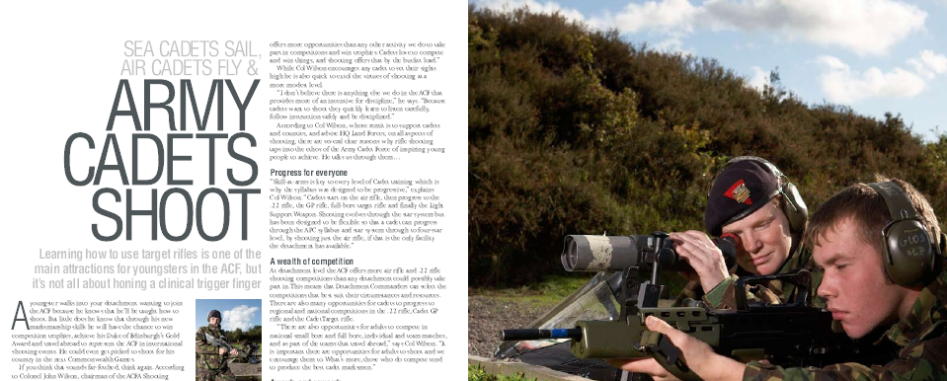
Shooting in the ACF – Recruiting & Retention
ACF Attitude Survey 2009
Lots of Opportunities for older cadets
ARMY CADET FORCE
MAKE YOUR MARK

Slide 12
Shooting in the ACF – Recruiting & Retention
ARMY CADET FORCE
MAKE YOUR MARK

Slide 13
ACF Shooting Officers’ Conference – the role of shooting in the ACF
Recruiting & Retention
APC Training Syllabus
Competitions
Duke of Edinburgh’s Award

Slide 14
ACF Shooting Officers’ Conference – the role of shooting in the ACF
b. APC TRAINING SYLLABUS
Shooting
Core syllabus subject
At all levels
Progressive
Flexible

Slide 15
ACF Shooting Officers’ Conference – the role of shooting in the ACF
Recruiting & Retention
APC Training Syllabus
Competitions
Duke of Edinburgh’s Award

Slide 16
ACF Shooting Officers’ Conference - competitions
The Values of Competition Shooting
Encourages high standards
Provides incentive to do well
Excellent for character building
Helps to develop qualities
Determination - Concentration - Self-reliance
Leadership - Esprit de Corps
Encourages care, maintenance and safe handling of rifles

Slide 17
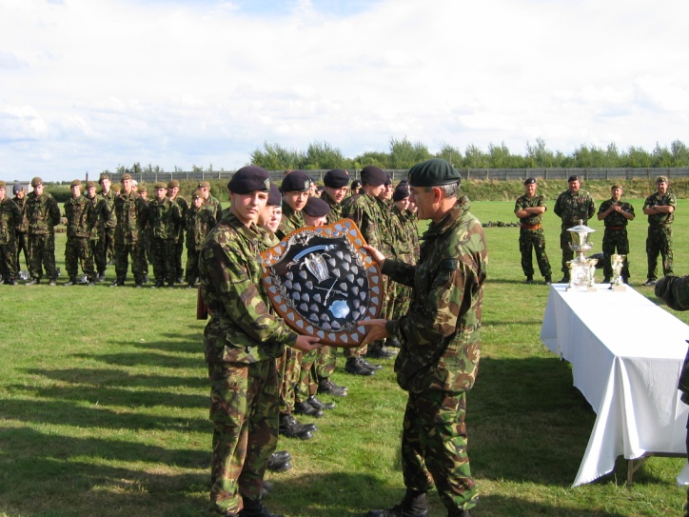
ACF Shooting Officers’ Conference - competitions
Reg Comd ACF Shooting Directive
SHOOTING COMPETITIONS AND ACTIVITIES THAT SATISFY THE REQUIREMENTS OF THE APC (ACF) SYLLABUS
Notes:
Explain that there are lots of competitions in all disciplines
Units will not be able to enter them all
Should select the ones which are most appropriate / convenient
I will highlight some of the most important competitions that counties should consider

Slide 18
ACF Shooting Officers’ Conference - competitions
.22 RIFLE
Cadet Hundred - indiv & team
c1500 cadets; 260 Dets; 30 Counties
News of the World – detachment team (any .22 rifle)
Walter Kirke Trophy – detachment team (No. 8 Rifle as issued)
Notes:
.22 Cadet Hundred – explain
Annual
any .22 rifle
Any distance – 15 / 20/ 25 yds
Non-central – det locations
Cheap – 50p per cadet
Round 1 Aug-Dec = 2 targets per cadet
Round 2 (top 200 from Round 1) Jan-Feb = 2 targets per cadet
1st – Trophy – ACF Champions Badge – Cadet Hundred Badge
2nd – Medal – Cadet Hundred Badge
3rd – Medal – Cadet Hundred Badge
4th to 100th – Cadet Hundred Badge
Top 40 selected for the ACF Team –v- SCC & ATC for the Whistler Trophy. Awarded ACF Colours
Concurrent with the Indiv is a Det Team Match (4 cadets)
News of the World – explain
Annual
any .22 rifle
Any distance – 15 / 20/ 25 yds
Non-central – det locations
Det Team of 4
Same conditions as the ACF Cadet Hundred comp
Three Stages
1 – Aug-Dec
2 – Jan-Feb
Final Mar/Apr at NSRA Lord Roberts House Bisley Camp
Top 2 Det Teams in Stage 2
shoot the Final for the News of the World Trophy
Join together as the ACF Team –v- the ATC & SCC for the Punch Trophy (receive ACF Colours)

Slide 19
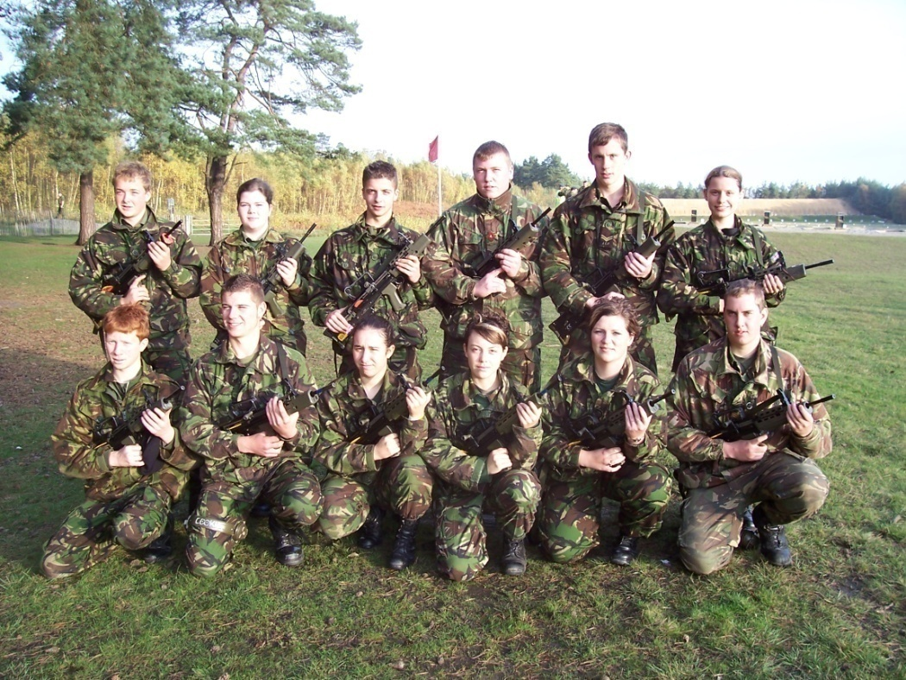
ACF Shooting Officers’ Conference - competitions
GP RIFLE
Brigade Skill at Arms Meetings - Sep
Cadet Inter-Service Skill at Arms Meeting (CISSAM) - Pirbright - Oct
Tri-Service – 52 Teams – 260 Cadets – 150 Adults
Notes:
Explain CISSAM
Annual
Brunswick Camp & Pirbright Ranges
Assemble Thu and shoot Fri-Sat-Sun
Tri-Service
Service Rifle
Deliberate – Rapid – Snap – Run Down – Falling Plate – Clay Target
Indiv & team
Adult Match
Lots of medals / trophies
Inter-Service Match (Top 6 ACF Cadets –v- SCC & ATC receive ACF Colours)

Slide 20
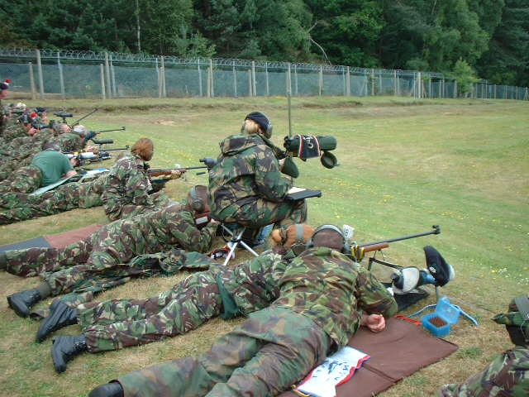
ACF Shooting Officers’ Conference - competitions
TARGET RIFLE
Brigade TR Meetings - May
Inter-Service Cadet Rifle Meeting (ISCRM) - Bisley - Jul
NRA Imperial Meeting - Bisley - Jul
National Teams abroad
Notes:
Explain ISCRM
Explain NRA Imperial Meeting
National teams Abroad = more later

Slide 21
ACF Shooting Officers’ Conference - competitions
TARGET RIFLE
Tri-Service
125 Teams
625 Cadets
250 Adults
Brigade TR Meetings - May
Inter-Service Cadet Rifle Meeting (ISCRM) - Bisley - Jul
NRA Imperial Meeting - Bisley - Jul
National Teams abroad
RCAC NRT
ADF CRT
SA Juniors
International
Notes:
Explain ISCRM
Explain NRA Imperial Meeting
National teams Abroad = more later

Slide 22
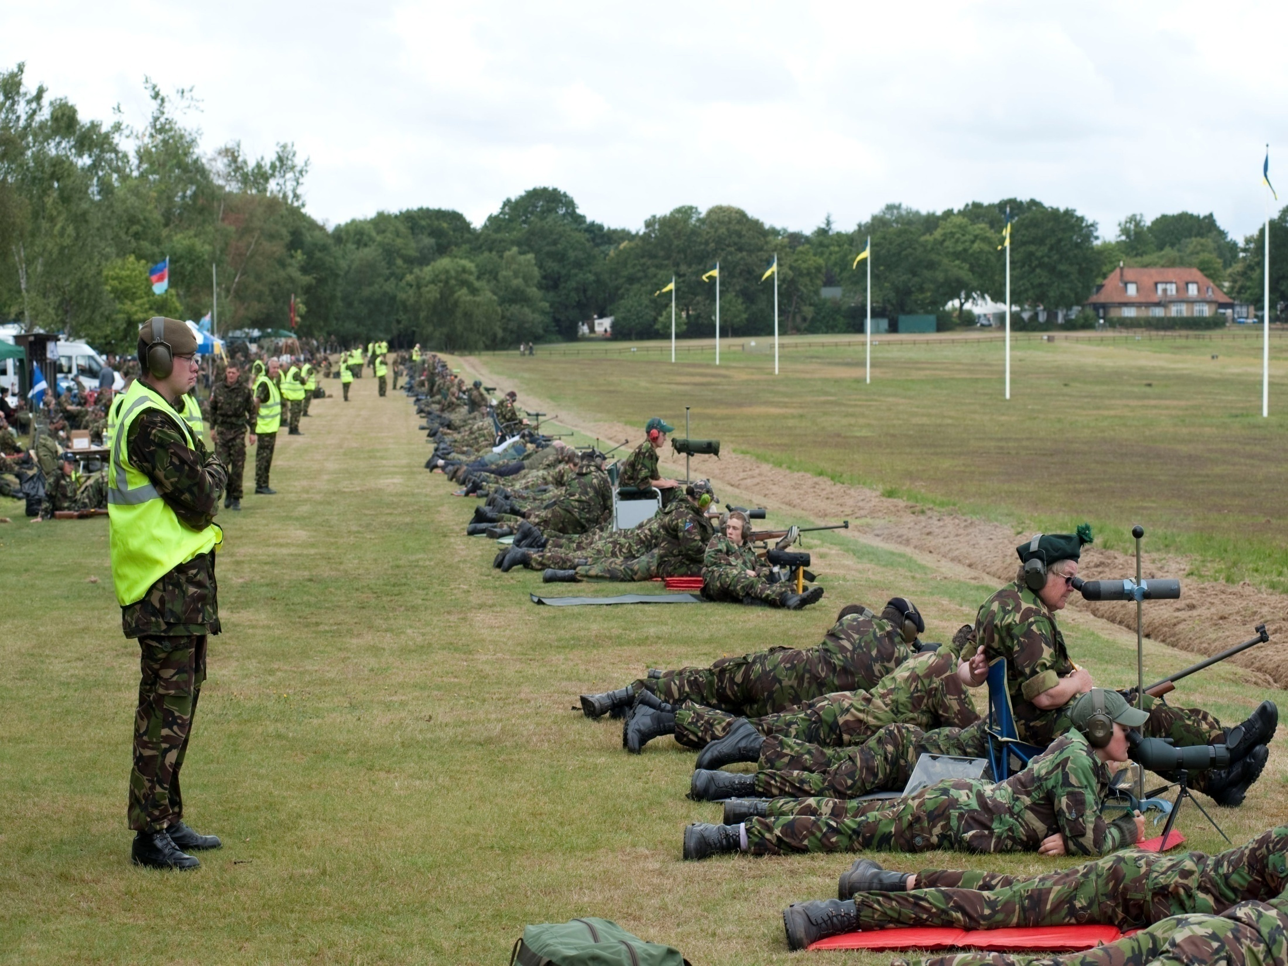
Shooting in the ACF
ARMY CADET FORCE
MAKE YOUR MARK

Slide 23
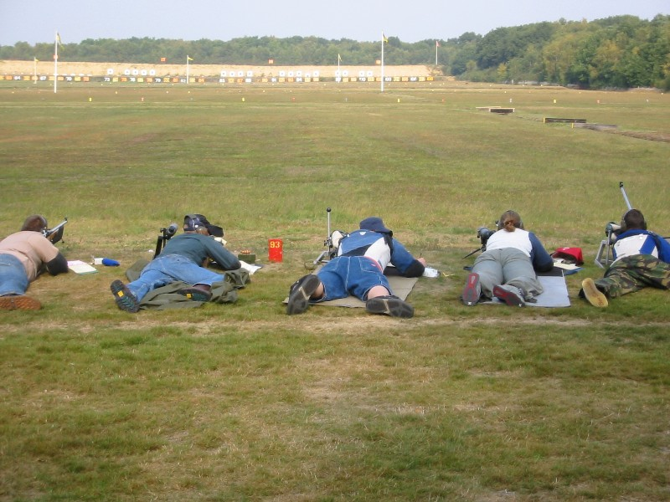
ACF Shooting Officers’ Conference- competitions
COMPETITIONS OVERSEAS
British Cadet Rifle Team (Athelings) - Canada
GB U19 Rifle Team - South Africa
UK Cadet Rifle Team - Channel Islands
Marksmanship Course - Canada

Slide 24
ACF Shooting Officers’ Conference - competitions
ADULTS
TARA Smallbore - indiv & team
TARA Fullbore - indiv & team
ISCRM
NRA Imperial Meeting
CISSAM
Overseas Teams

Slide 25
The Competition Shooting Seasons
BCRT Canada
RCAC CLIM Cse
GB U19 South Africa
NRA IMP MEETING
ANNUAL CAMPS
CISSAM
ISCRM
BDE SR MEETINGS
ACF CDT HUNDRED
NEWS OF THE WORLD
BDE TR MEETINGS
MAR
APR
MAY
JUN
JUL
AUG
SEP
OCT
NOV
DEC
JAN
FEB
FULL BORE TARGET RIFLE
SERVICE (GP) RIFLE
.22
.22 RIFLE

Slide 26
ACF Shooting Officers’ Conference – the role of shooting in the ACF
Recruiting & Retention
APC Training Syllabus
Competitions
Duke of Edinburgh’s Award

Slide 27
ACF Shooting Officers’ Conference – the role of shooting in the ACF
d. DUKE OF EDINBURGH’S AWARD
VOLUNTEERING
PHYSICAL
EXPEDITION
SKILLS
RESIDENTIAL
Shooting
Gold - Silver - Bronze

Slide 28
ACF Shooting Officers’ Conference
HOW CAN WE DO BETTER?
Who can help you?
ACF Shooting Committee
The Council for Cadet Rifle Shooting (CCRS)
National Rifle Association (NRA)
National Small-Bore Rifle Association (NSRA)
ARMY CADET FORCE
MAKE YOUR MARK

Slide 29
ACFA Shooting Committee
Lt Col M Geernaert –Davies Chairman
CAPT Daf Marston
(CCRS)
Secretary
ACFA
CTC FP
ARMY HQ
NSRA
REGIONS
NRA

Slide 30
ACFA Shooting Committee – Regional Reps
HQ NW Bde Capt P Anderston G Manchester
15 Bde Lt K Dods Durham
42 Bde Capt R Leonard Isle of Man
HQ SW Bde Maj P Cawkwell Somerset
7 Bde Lt B Hirst Derbyshire
51 & 52 Bdes (Scot) Lt Halley Glasgow CCF
38 Bde (NI) Capt C Cooper 2(NI) Bn
11 Sigs Bde Capt I Robertson Warwks & WM(S)
11 Inf Bde Lt M Johnson Bucks
160 Bde (Wales) Maj I Dyas Gwent & Powys
London District Lt Col M Ludlow SW London Sector

Slide 31
ACFA Shooting Committee – Terms of Reference
APC Syllabus
Competitions
ISCRM
CISSAM
Inter-Service Matches
SO Conferences
Bde Coaching Courses
CTC FP Coaching Courses
Pre-Bisley Coach Cse
Canada Course

Slide 32
Council for Cadet Rifle Shooting (CCRS)
Independent Registered Charity
To support sport shooting activities in the Cadet Forces

Slide 33
Council for Cadet Rifle Shooting (CCRS)
Derby Lodge, Bisley Camp
Chairman – Brig Matthew Lowe
Permanent Secretariat
Gen Sec Brig Mark Pountain
Comps Manager Daf Marston
Shooting Manager Peter Turner
Admin Officer Gina Ansell
01483 473095

Slide 34
Council for Cadet Rifle Shooting (CCRS)
TASKS:
LIAISE WITH CADET UNITS AND SHOOTING ORGANISATIONS
DISEMINATE INFO ON TARGET SHOOTING
ARRANGE & ADMINISTER RIFLE MEETINGS AND NON-CENTRAL MATCHES
ORGANISE COACHING COURSES
SELECT, ORGANISE & ADMINISTER CADET TEAMS AT HOME & OVERSEAS
HOST TEAMS FROM ABROAD

Slide 35
Council for Cadet Rifle Shooting (CCRS)
CCRS COMMITTEES:
Trustees
Schools Committee
Inter-Service Cadet Rifle Matches Committee
Overseas Matches Committee
British Cadet Rifle Team (Athelings)
Great Britain Under 19 Team
United Kingdom Cadet Rifle Team

Slide 36
The Aim of this Conference?
ACF Shooting Officers’ Conference
Identify and solve problems / concerns
Share best practice
Improve the standard
Increase participation in competitions

Slide 37
Evaluation Questionnaire
ACF Shooting Officers’ Conference

Slide 38
Shooting in the ACF
QUESTIONS ?

Slide 39
Army Cadet Force Shooting Officers’ Conference 24-26 Jan 2019

Slide 40
Warm-up: Who are we?
ACF Shooting Officers’ Conference
Rank
Full Name
Unit
Previous Appointments
Current Appointment
Main challenge in delivering shooting

